Slide 1
Uninformed Searches
IDS
Lecture 6

Slide 2
Properties of Uniform‐CostSearch
Complete: Yes if arc costs > 0.
Optimal: Yes
Time and space complexity:O(b^{d}) (i.e.,exponential)
d is the depth of thesolution
is the branching factor at each non‐leafnode
More precisely, time and space complexity is O(b^{C*/ε} ) where a l edge costs ε ∑ > 0, and is the best goalpath cost

Slide 3
Iterative‐Deepening Search(IDS)
requires modification to DFS searchalgorithm:
do DFS to depth1
and treat a l children of the start node as leaves
if no solution is found, do DFS to depth 2
repeat by increasing “depth bound” until a solution found
Start node is at depth 0

Slide 4
Iterative‐Deepening Search(IDS)
Node deepeningSearch (Problem problem) { int depth = 1;
Stack DSnodes = new Stack();
while (true) { // while not solved
Node node = DFS_depthBound(problem, DSnodes, depth);
// DFS_depthBound limits DFS search to level <= depth
if (node isn't "failure") return node; // solved depth++; // look deeper
}
}

Slide 5
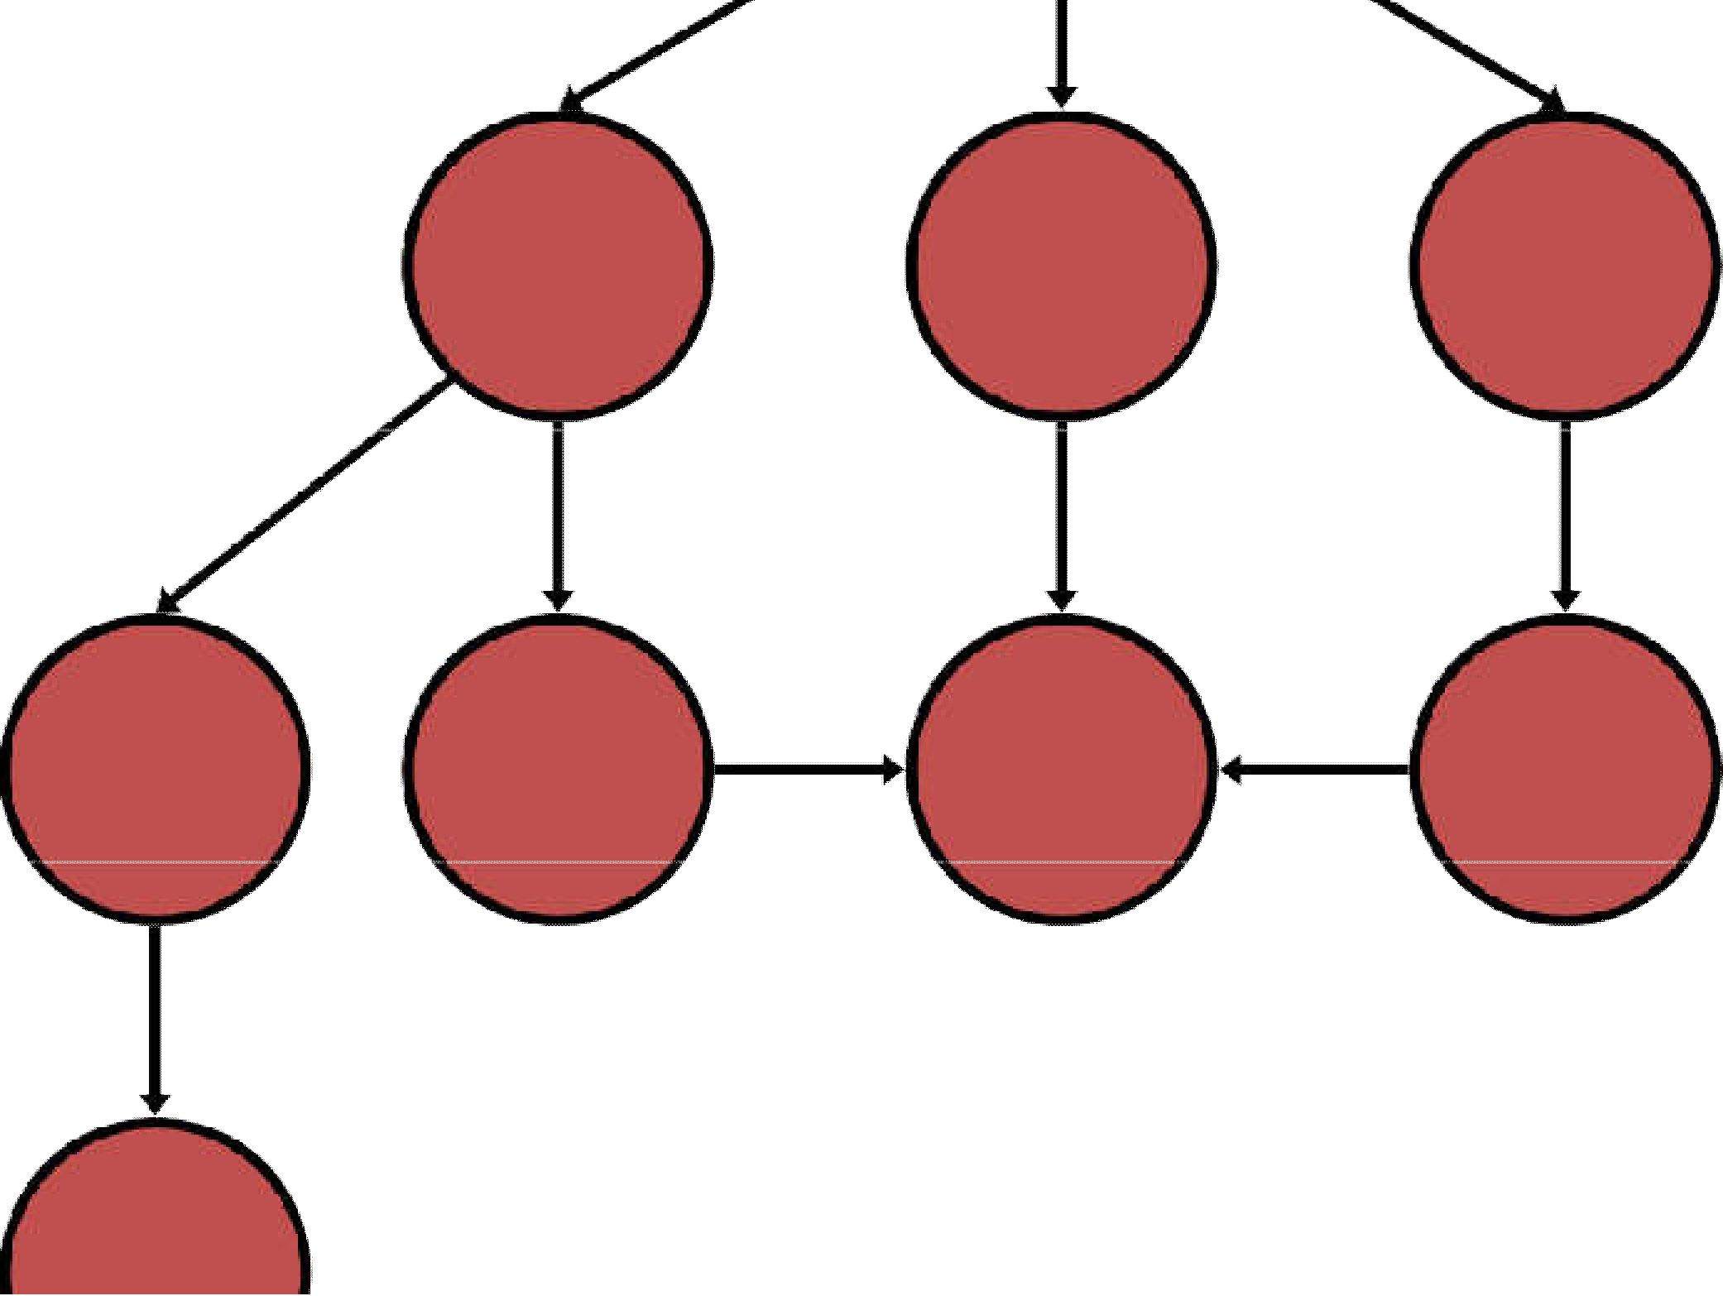
Iterative‐Deepening Search(IDS)
deepeningSearch(problem)
depth: 1, # of nodes expanded: 0, tested: 0
S
start
expnd. node | Frontier
 | {S}
5
2
4
A
B
C
9
4
6
G
goal
2
D
E
6
1
F
7
H

Slide 6

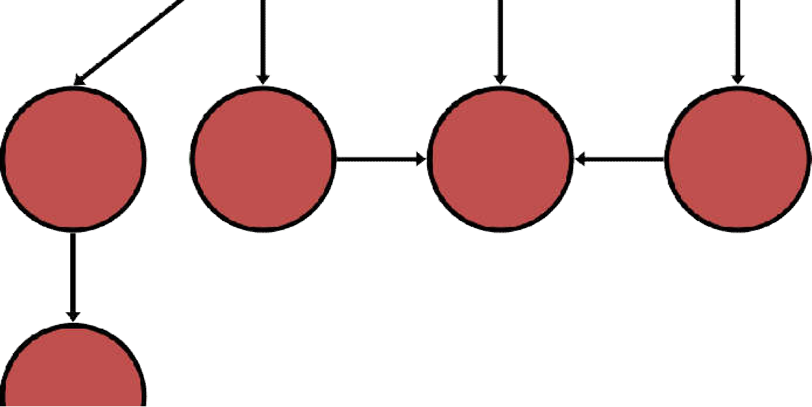
Iterative‐Deepening Search(IDS)
deepeningSearch(problem)
depth: 1, # of nodes tested: 1, expanded: 1
S
start
expnd. node | Frontier
 | {S}
S not goal | {A,B,C}
5
2
4
A
B
C
9
4
6
G
goal
2
D
E
6
1
F
7
H

Slide 7


Iterative‐Deepening Search(IDS)
deepeningSearch(problem)
depth: 1, # of nodes tested: 2, expanded: 1
S
start
expnd. node | Frontier
 | {S}
S | {A,B,C}
A not goal | {B,C} no expand
5
2
4
A
B
C
9
4
6
G
goal
2
D
E
6
1
F
7
H

Slide 8

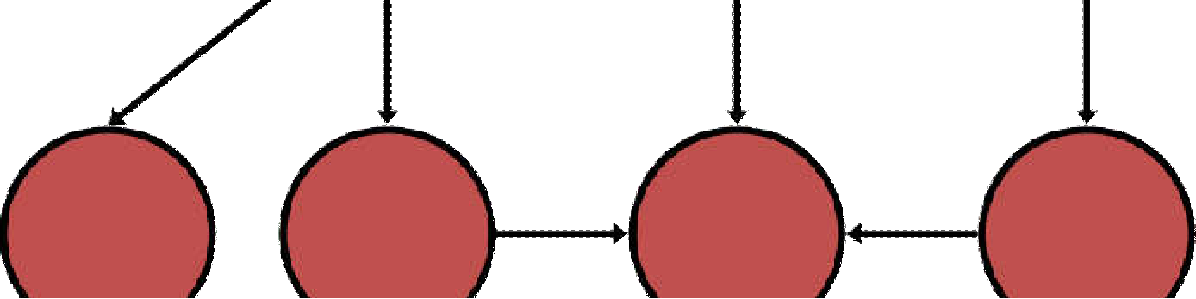
Iterative‐Deepening Search(IDS)
deepeningSearch(problem)
depth: 1, # of nodes tested: 3, expanded: 1
S
start
expnd. node | Frontier
 | {S}
S | {A,B,C}
A | {B,C}
B not goal | {C} no expand
5
2
4
A
B
C
9
4
6
G
goal
2
D
E
6
1
F
7
H

Slide 9


Iterative‐Deepening Search(IDS)
deepeningSearch(problem)
depth: 1, # of nodes tested: 4, expanded: 1
S
start
expnd. node | Frontier
 | {S}
S | {A,B,C}
A | {B,C}
B | {C}
C not goal | { } no expand-FAIL
5
2
4
A
B
C
9
4
6
G
goal
2
D
E
6
1
F
7
H

Slide 10


Iterative‐Deepening Search(IDS)
deepeningSearch(problem)
depth: 2, # of nodes tested: 4(1), expanded: 2
S
start
expnd. node | Frontier
 | {S}
S | {A,B,C}
A | {B,C}
B | {C}
C | { }
S no test | {A,B,C}
5
2
4
A
B
C
9
4
6
G
goal
2
D
E
6
1
F
7
H

Slide 11
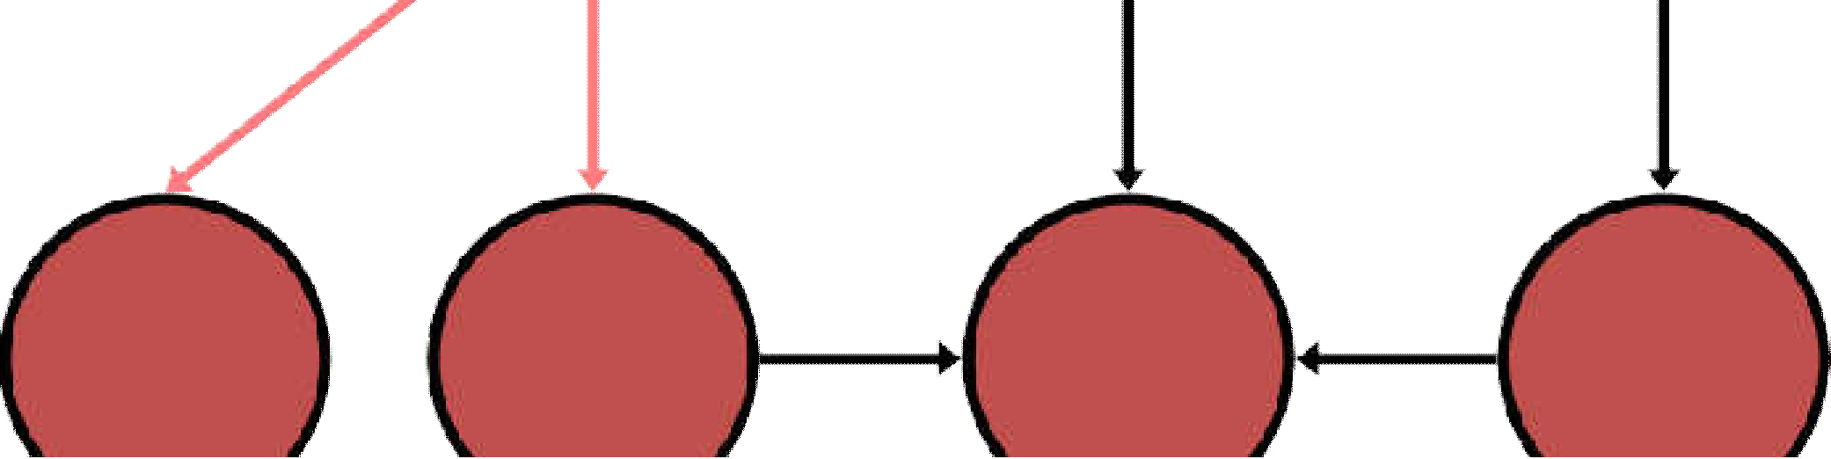
Iterative‐Deepening Search(IDS)
deepeningSearch(problem)
depth: 2, # of nodes tested: 4(2), expanded: 3
S
start
expnd. node | Frontier
 | {S}
S | {A,B,C}
A | {B,C}
B | {C}
C | { }
S | {A,B,C}
A no test | {D,E,B,C}
5
2
4
A
B
C
9
4
6
G
goal
2
D
E
6
1
F
7
H

Slide 12

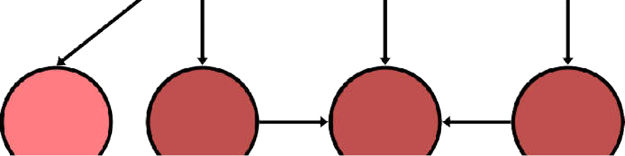
Iterative‐Deepening Search(IDS)
deepeningSearch(problem)
depth: 2, # of nodes tested: 5(2), expanded: 3
S
start
expnd. node | Frontier
 | {S}
S | {A,B,C}
A | {B,C}
B | {C}
C | { }
S | {A,B,C}
A | {D,E,B,C}
D not goal | {E,B,C} no expand
5
2
4
A
B
C
9
4
6
G
goal
2
D
E
6
1
F
7
H

Slide 13

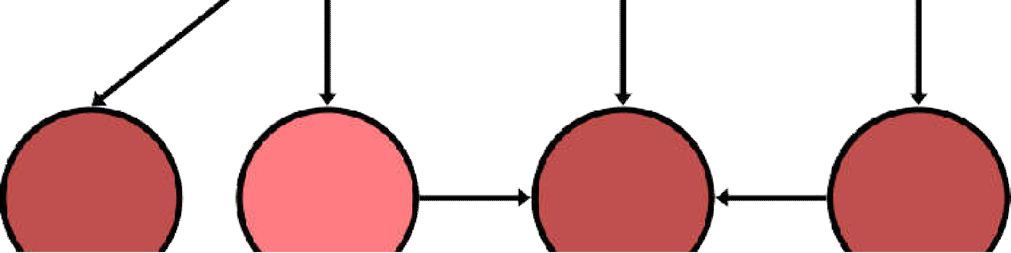
Iterative‐Deepening Search(IDS)
deepeningSearch(problem)
depth: 2, # of nodes tested: 6(2), expanded: 3
S
start
expnd. node | Frontier
 | {S}
S | {A,B,C}
A | {B,C}
B | {C}
C | { }
S | {A,B,C}
A | {D,E,B,C}
D | {E,B,C}
E not goal | {B,C} no expand
5
2
4
A
B
C
9
4
6
G
goal
2
D
E
6
1
F
7
H

Slide 14
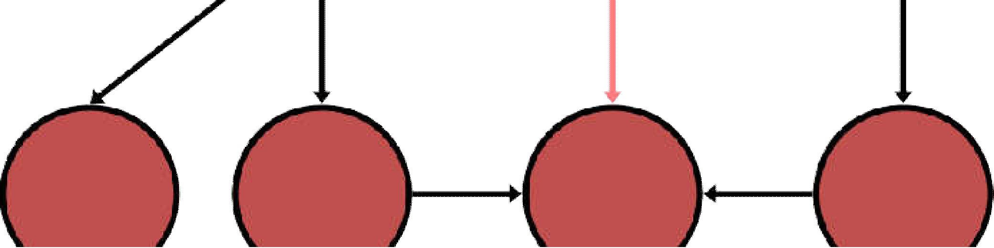
Iterative‐Deepening Search(IDS)
deepeningSearch(problem)
depth: 2, # of nodes tested: 6(3), expanded: 4
S
start
expnd. node Frontier
{S}
5
2
4
S {A,B,C}
A. {B,C}
A
B
C
{C}
{ }
6
G
goal
9
4
2
S {A,B,C}
D
E
6
1
F
A D.
E.
B no test
{D,E,B,C}
{E,B,C}
{B,C}
{G,C}
7
H

Slide 15
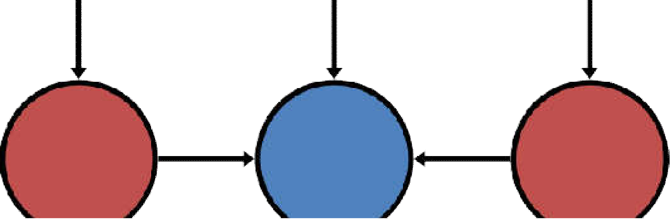
Iterative‐Deepening Search(IDS)
deepeningSearch(problem)
depth: 2, # of nodes tested: 7(3), expanded: 4
S
start
expnd. node | Frontier
 | {S}
S | {A,B,C}
A | {B,C}
B. | {C}
C. | { }
S | {A,B,C}
A | {D,E,B,C}
5
2
4
A
B
C
9
4
6
6 G 1
goal
2
D
E
F
D.
E. B
G goal
{E,B,C}
{B,C}
{G,C}
{C} no expand
7
H

Slide 16
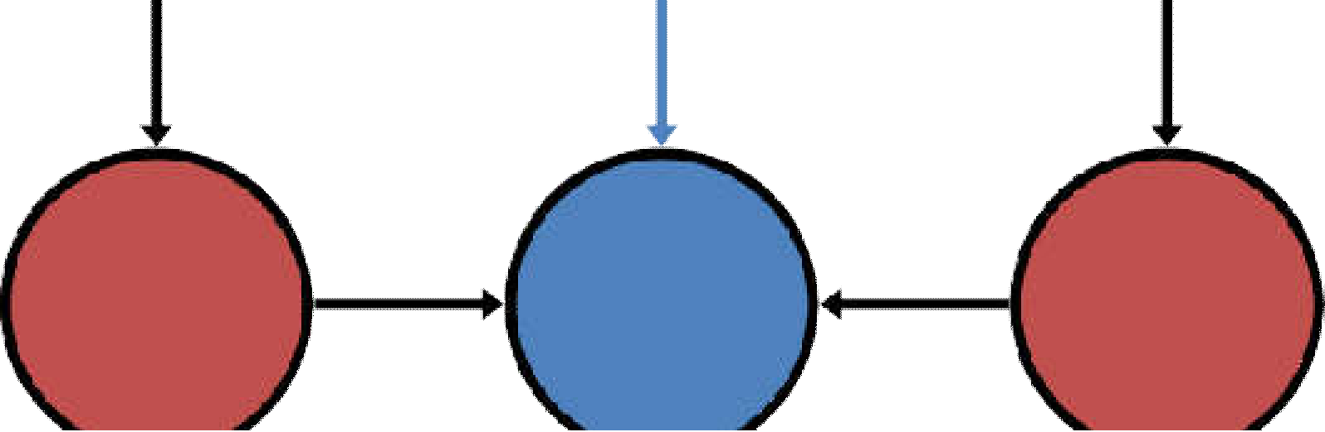
Iterative‐Deepening Search(IDS)
deepeningSearch(problem)
depth: 2, # of nodes tested: 7(3), expanded: 4
S
start
expnd. node Frontier
{S}
5
2
4
S {A,B,C}
{B,C}
{C}
{ }
S {A,B,C}
A {D,E,B,C}
{E,B,C}
{B,C}
A
B
C
9
4
6
G
goal
2
D
E
6
1
F
7
path: S,B,G cost: 8
B G
{G,C}
{C}
H

Slide 17
Iterative‐Deepening Search(IDS)
Has advantages of BFS
completeness
optimality as stated for BFS
Has advantages of DFS
limited space
in practice, even with the redundant effort still finds longer paths more quickly than BFS

Slide 18
Iterative‐Deepening Search(IDS)
Space complexity: O(bd) (i.e., linear like DFS)
Time complexity is a little worse than BFS or DFS
because nodes near the top of the search tree are generated multiple times (redundanteffort)
Worst case time complexity: O(b^{d}) exponential
because most nodes are near the bottom of tree

Slide 19
Iterative‐Deepening Search(IDS)
Howmuch redundant effort is done?
The number of times the nodes are generated:
1b^{d} + 2b^{(d- 1 )} + ... + db ≤ b^{d} / (1 – 1/b)²
= O(b^{d})
d: the solution's depth
: the branching factor at each non‐leaf node
For example: b = 4
4^{d} / (1 – ¼)² = 4^{d} / (.75)² = 1.78 × 4^{d}
in the worst case, 78% more nodes are
searched (redundant effort) than exist at depthd
as increases, this % decreases
5
0

Slide 20
Iterative‐Deepening Search
Trades a little time for a huge reduction in space
– lets you do breadth‐first search with (morespace efficient) depth‐first search
applications, e.g.,games
Anytime algorithm: good for response‐timecritical
An “anytime”algorithm is an algorithm that can return a valid solution to aproblem even if it's interrupted atanytimebeforeitends.Thealgorithm is expected to find better and better solutions the more time it keepsrunning.

Slide 21
Iterative Deepening Search
It’s a Depth First Search, but it does it one level at a time, gradually increasing thelimit, until a goal is found.
Combine the benefits of depth‐firstand breadth‐first search
like DFS, modest memory requirements O(bd)
like BFS, it is complete when branching factor is finite, and optimal when the path cost is a nondecreasing function of the dept of the node

Slide 22
Iterative Deepening Search
Mayseem wasteful because states are generated multiple times
but actua ly not very costly, because nodes at the bottom level are generated onlyonce
In practice, however, the overhead of these multiple expansions is sma l, because most of the nodes are towards leaves (bottom) of the searchtree:
thus, the nodes that are evaluated severaltimes (towards top of tree) are in relatively smallnumber.
Iterative depending is the preferred uninformed search method when the search space is large and the depth of the solution is unknown

Slide 23
Properties of Iterative DeepeningSearch
Combines the best of breadth-first and depth- first search strategies.
Completeness: Yes,
Time complexity:
Space complexity:
Optimality:
O(b ^{d}
O(bd)
Yes, if step cost = 1
(1)+(b)+(b+b2)+(b+b2+b3)+⋯+(bd)

Slide 24
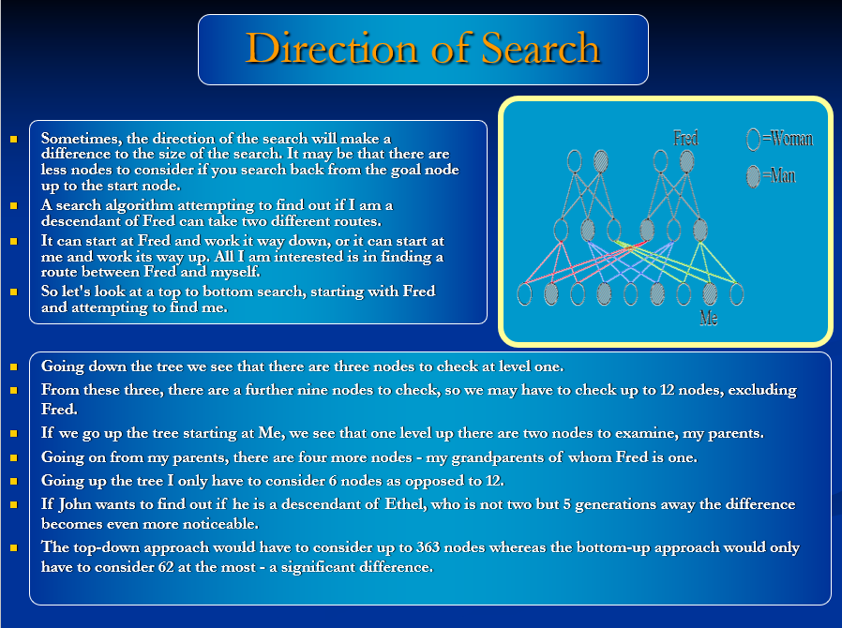

Slide 25
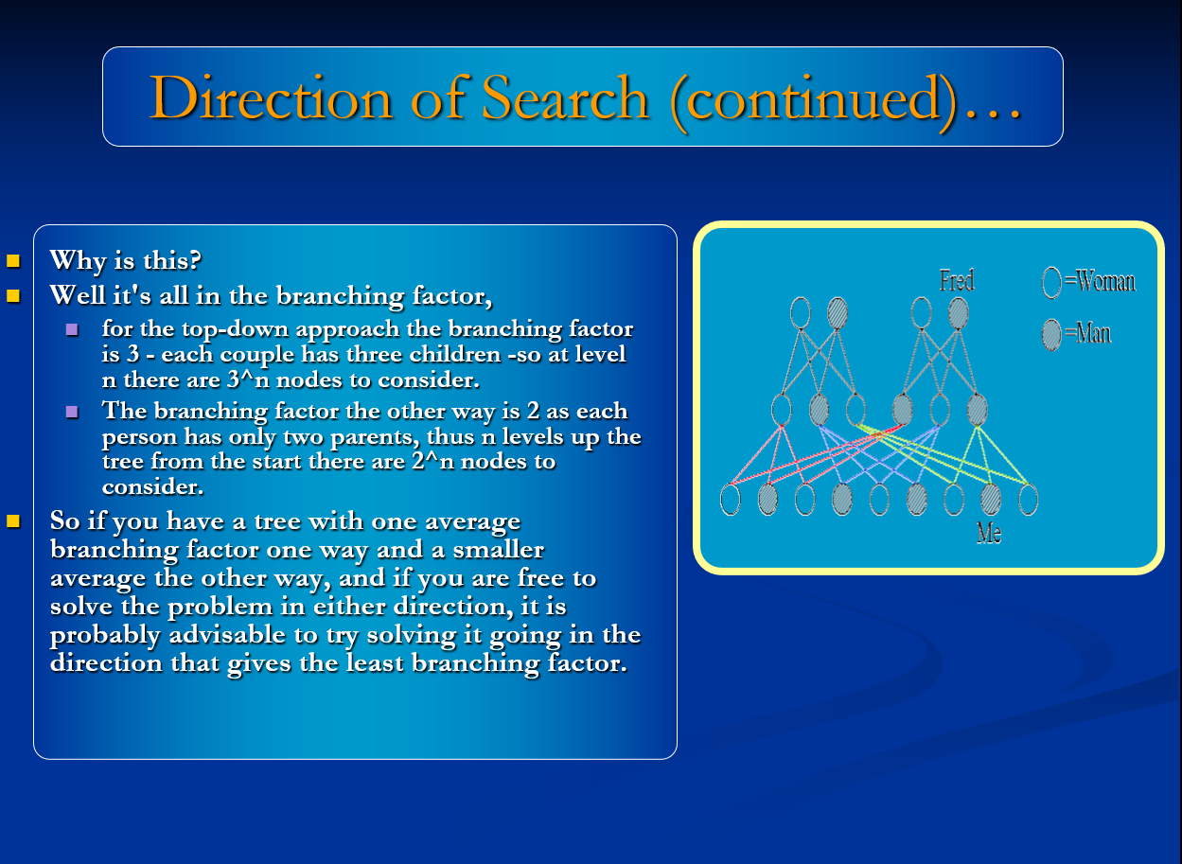

Slide 26
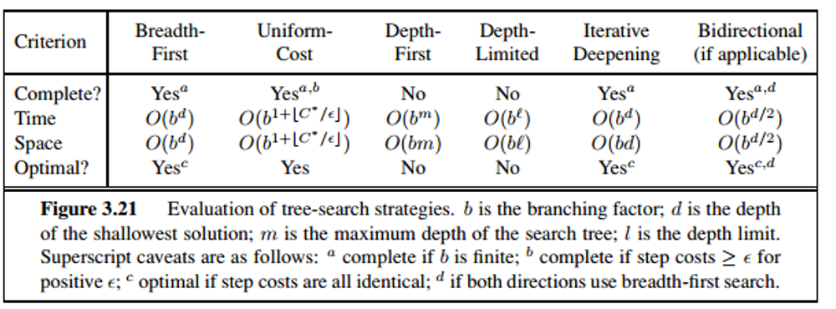
Comparison of Uninformed Searches

